Slide 1
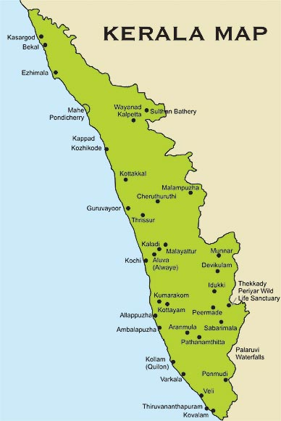

Keralam from “Kera vriksham”

Slide 2
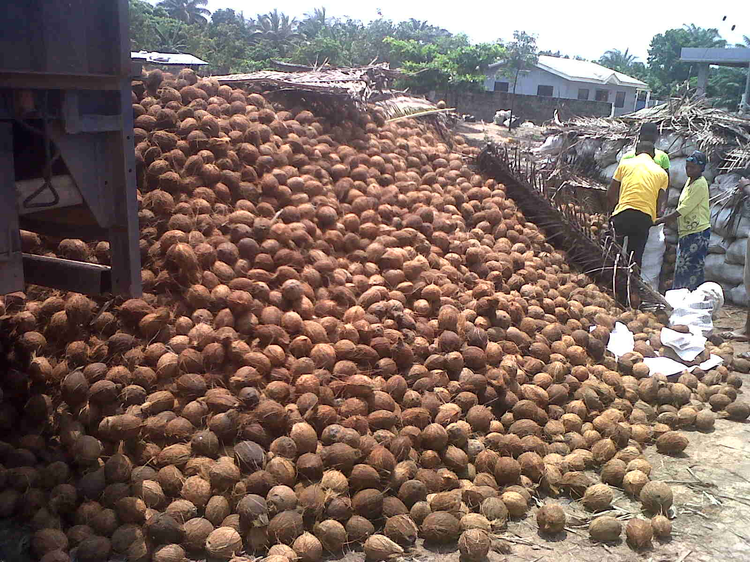
Importance
Coconut palm provides food security and livelihood to a large size of population in the world.

Slide 3
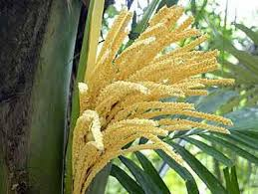
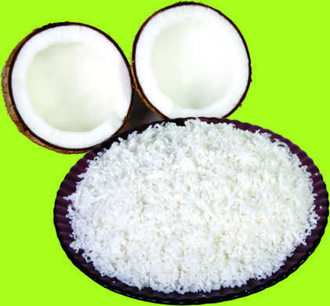
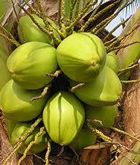
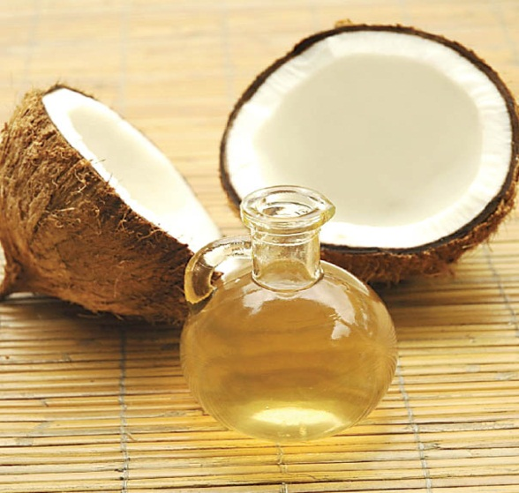
Multi various uses - Coconut palm is regarded as KALPAVRIKSHA (Tree of Heaven).

Slide 4
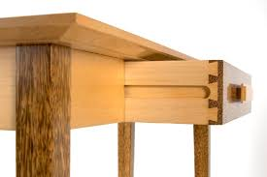
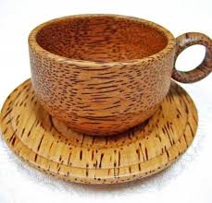
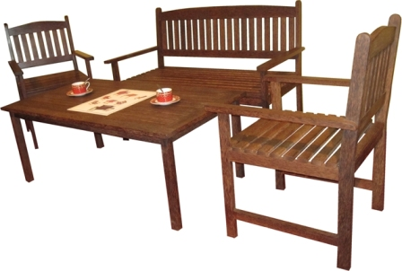
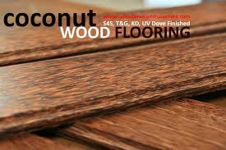
Coconut wood

Slide 5
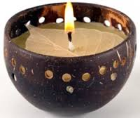
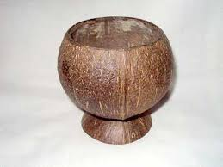
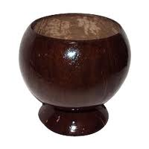
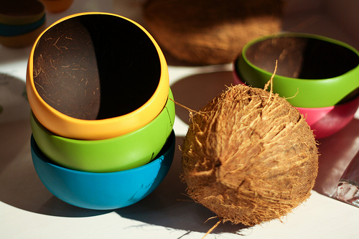
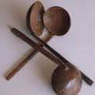
Handicrafts

Slide 6
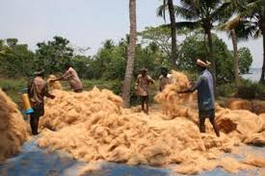
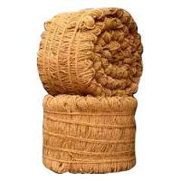
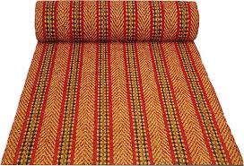

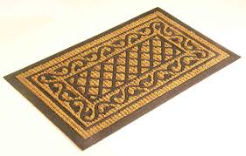
Coir and coir products

Slide 7
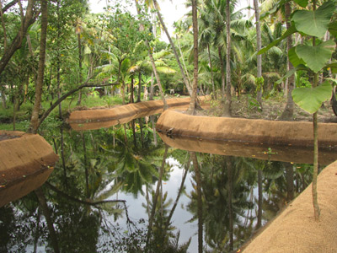
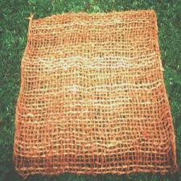
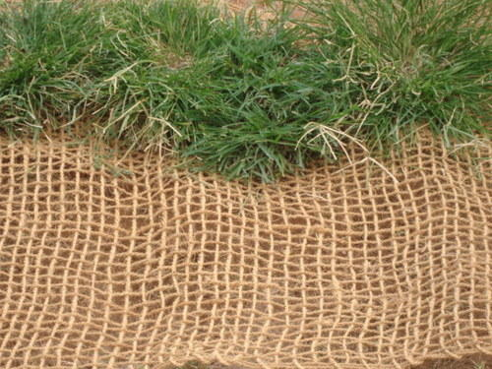
Geotextiles

Slide 8
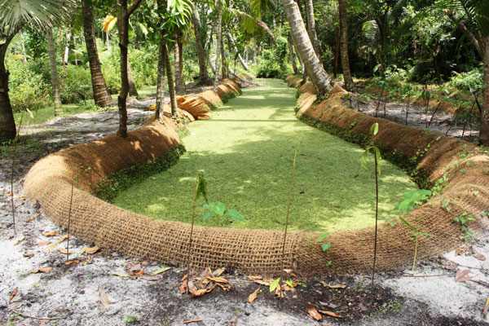
Bank strengthening – Geotextiles

Slide 9
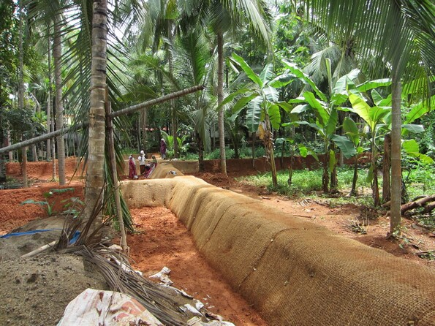
Bund strengthening – Geotextiles

Slide 10
Value addition

Slide 11
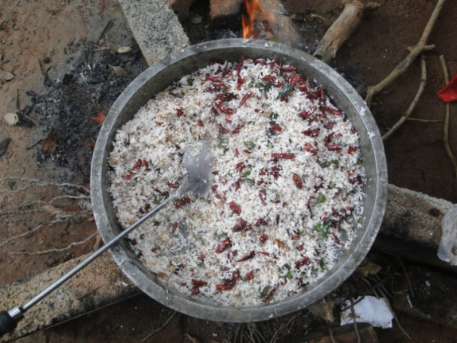
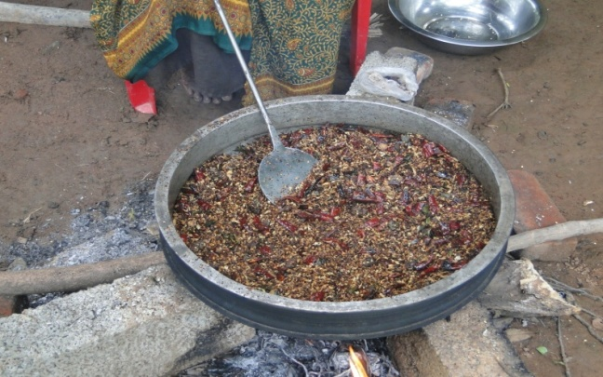
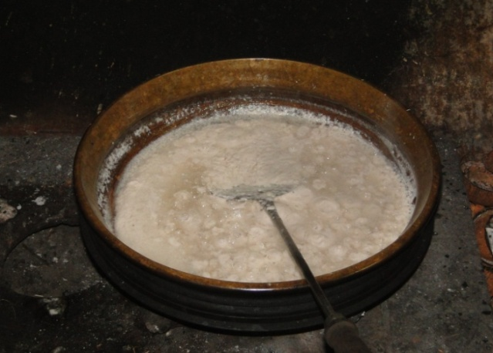
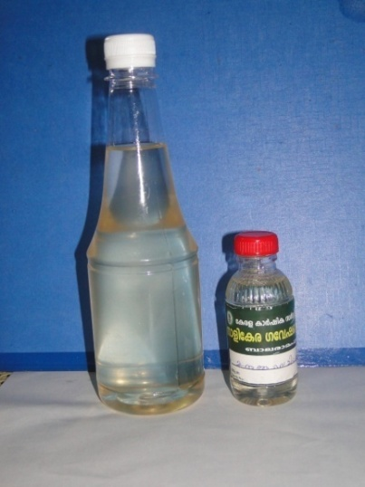
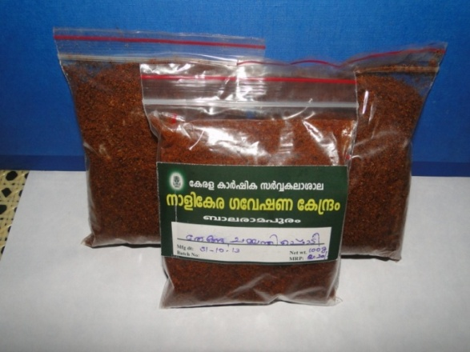
An array of value added products

Slide 12
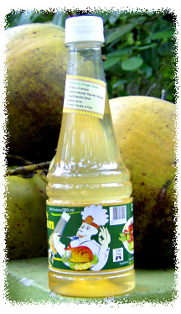
Products …
Coconut vinegar

Slide 13
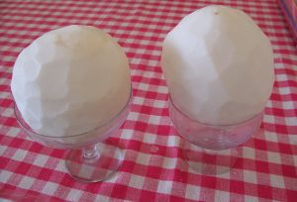
Snow ball tender coconut

Slide 14
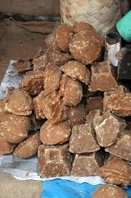
Coconut jaggery

Slide 15
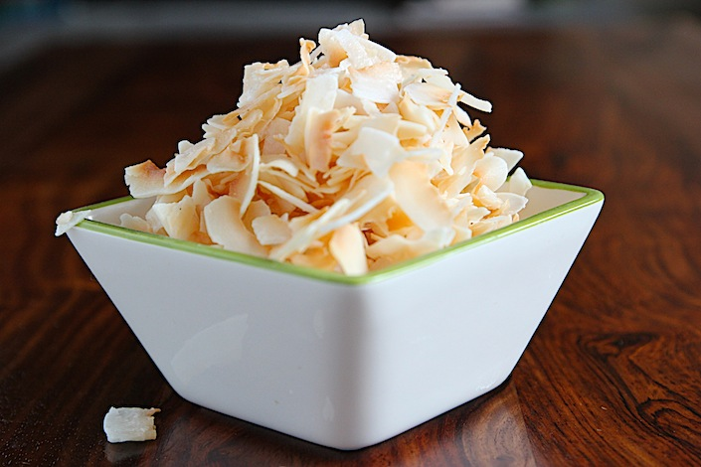
Coconut chips

Slide 16
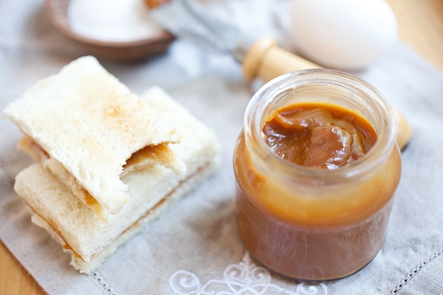
Coconut jam

Slide 17
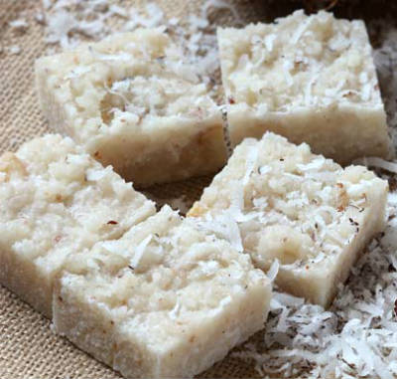
Coconut burfi

Slide 18
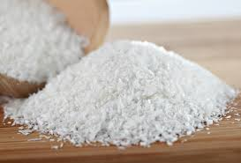
Coconut milk powder

Slide 19
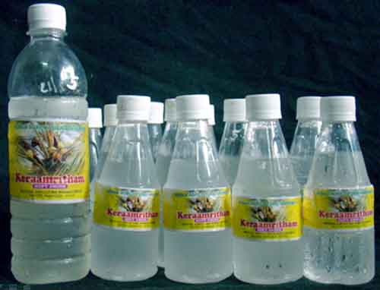
Neera

Slide 20
Coconut is
A source of food, beverage, medicine, natural fibre, fuel, wood and raw materials for units producing a variety of goods.
Interlinked with the socio economic life of large number of small and marginal farmers
About 12 million people in India are dependent on coconut cultivation, processing and trading activities

Slide 21
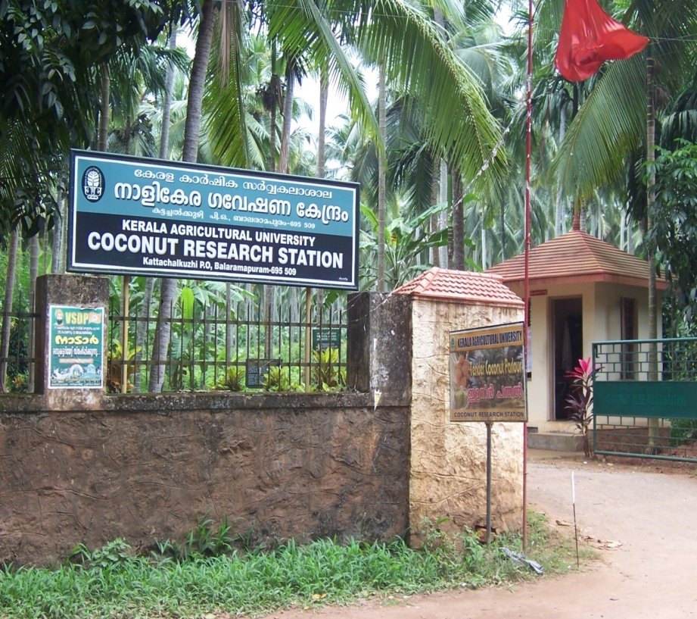
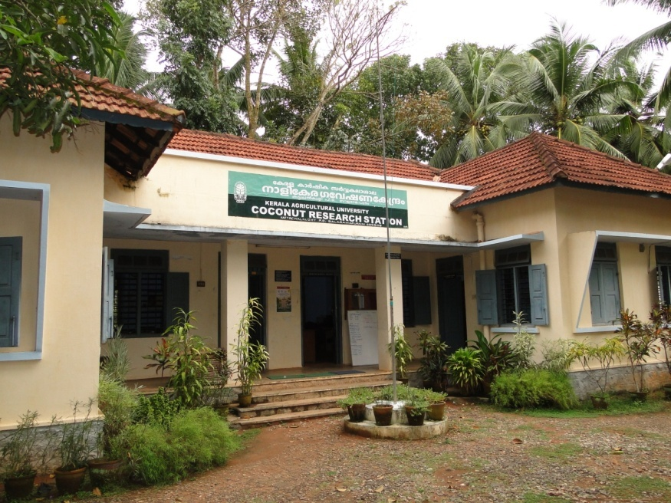
Coconut Research Station
Balaramapuram

Slide 22
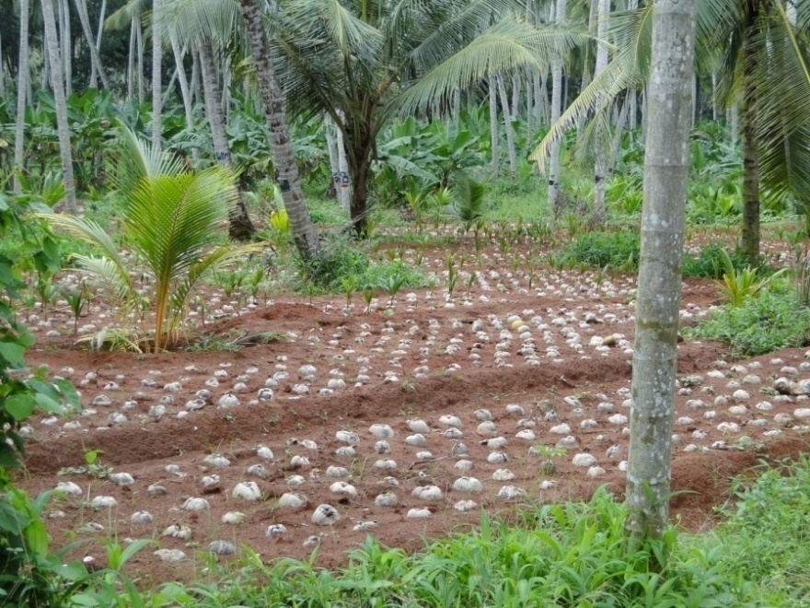
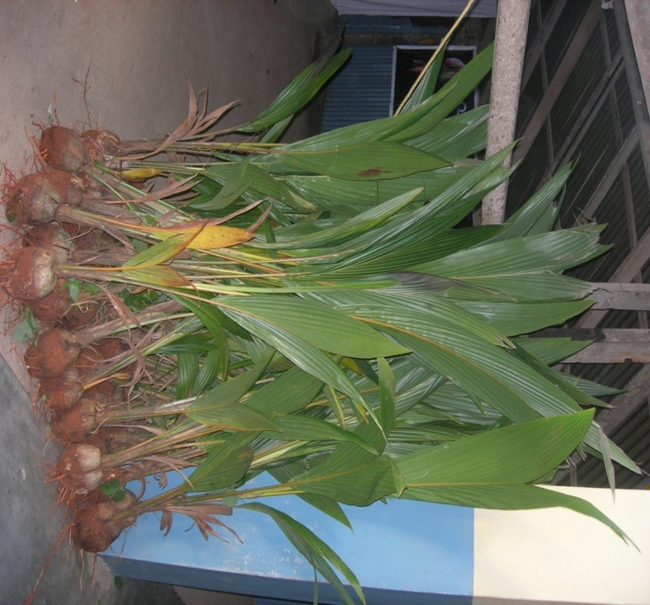
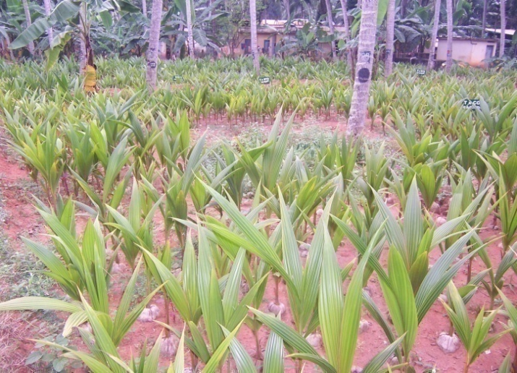
Production and supply of quality seedlings of coconut

Slide 23
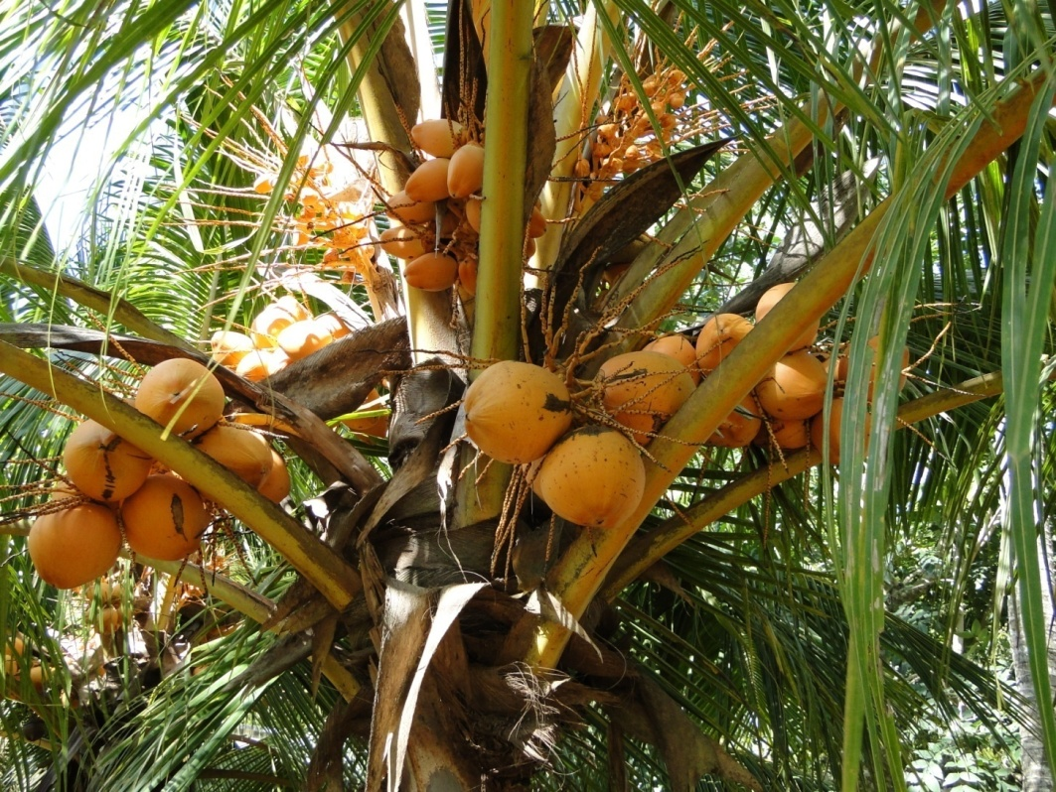
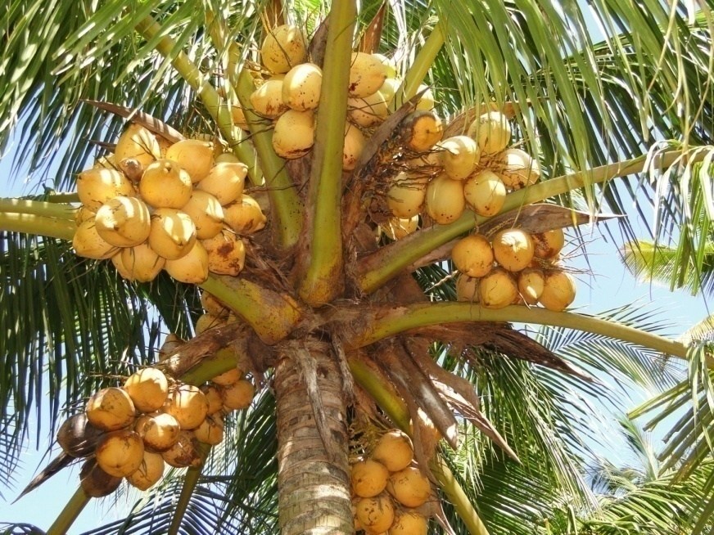
Dwarf palms maintained for hybridization - TXD

Slide 24

September 2
Celebrating since 1999.
Creating awareness on the importance of coconut, trainings on scientific cultivation of coconut, introducing new improved coconut varieties to farmers.

Slide 25
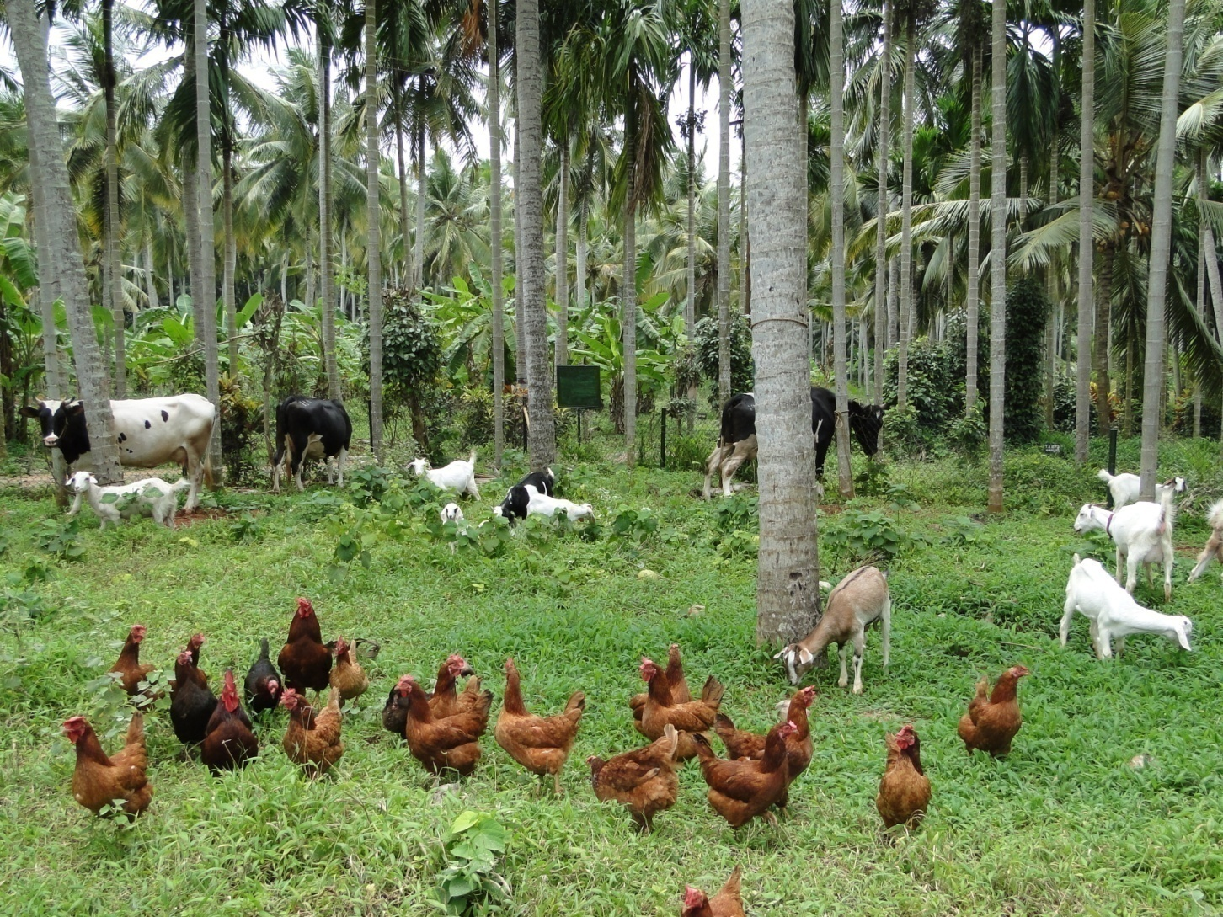
Coconut based farming system for homesteads

Slide 26
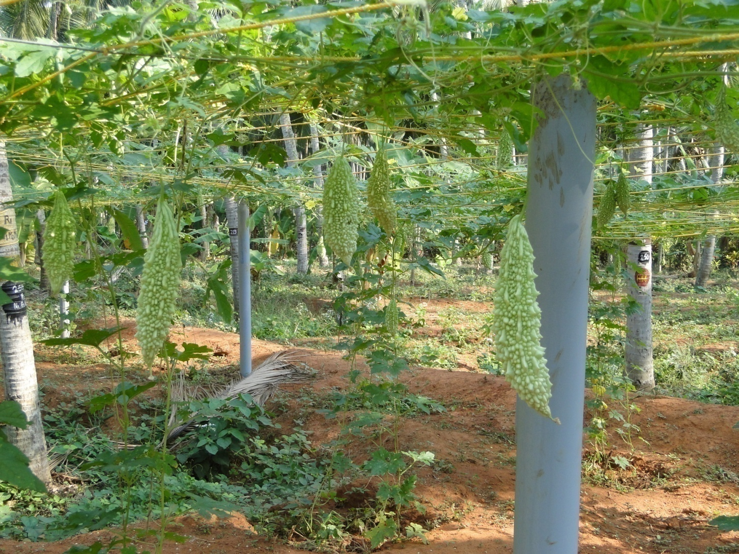
Vegetable production

Slide 27
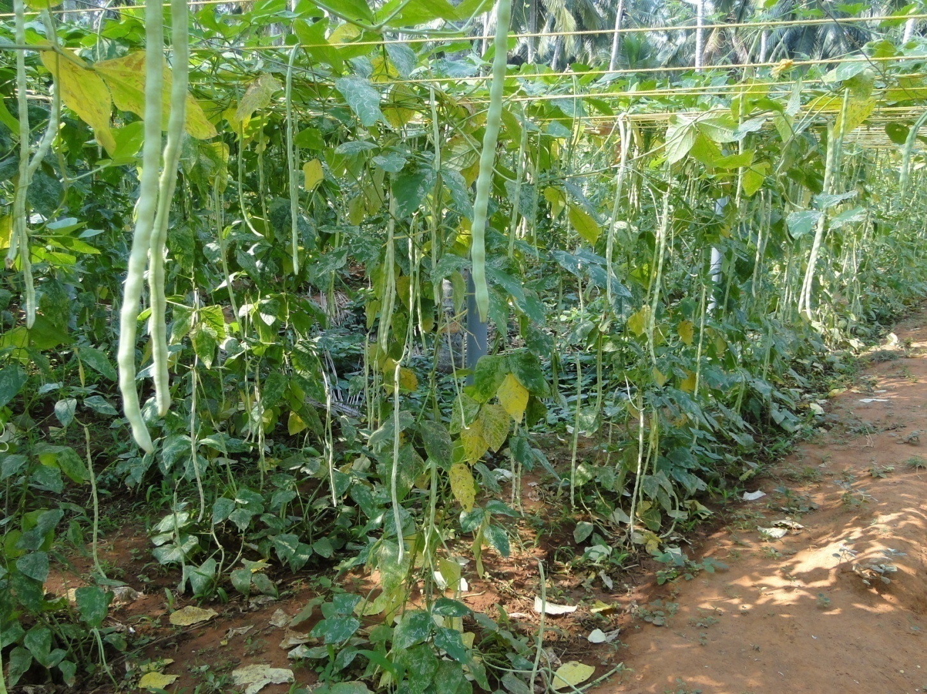
Vegetable production

Slide 28
Intercrops

Slide 29
Ample space for
Wide variety of Intercrops
7.5 m
56.25 m²
7.5 m

Slide 30
Space needed for each palm
2 m
II r² = 3.14x 2x2 = 12.56m²
44 m² area available for intercropping

Slide 31

Sunlight

Slide 32
Choice of intercrops
Up to 8 years – Ample light – Annuals
8- 25 years – Less light – Shade tolerant crops
Above 25 years – More light – Perennials

Slide 33
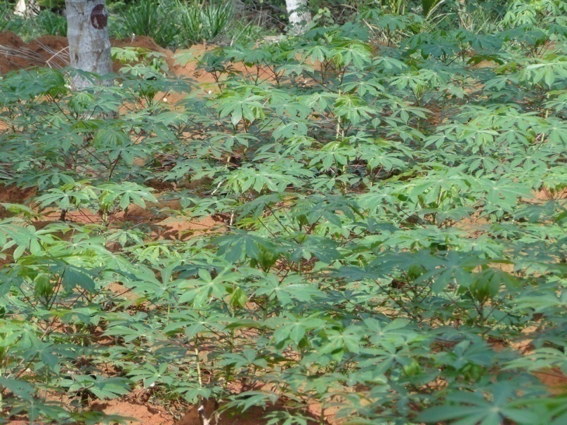
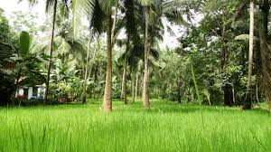
Annuals
Cereals – Rice
Tuber crops – Cassava

Slide 34
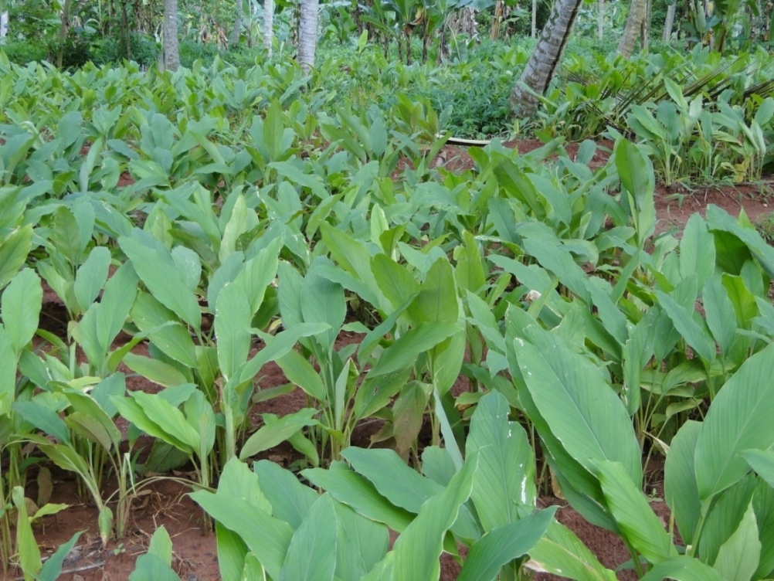

Shade tolerant crops
Ginger
Turmeric

Slide 35

Perennials
Beverage Crops - Cocoa

Slide 36



Perennial Spice trees
Nutmeg, clove, cinnamon

Slide 37


Other Spices –
Pepper , Chilli

Slide 38

Rapid multiplication in pepper

Slide 39

Fodder crops
Hybrid Napier, Guinea

Slide 40



Fruit crops
Banana, Pineapple, papaya

Slide 41



Tuber crops

Slide 42


A multi-storeyed cropping system
Well utilizing natural resources.

Slide 43
Planting of seedlings
Size of pits – depends upon soil types and water table
Loamy soil with low water table – 1mx1mx1m
Laterite soils with underlying rock – 1.2mx1.2mx1.2m
Sandy soil -0.75m x 0.75m x 0.75m
Spacing -7.5m

Slide 44

Method of planting
Pits be filled with top soil to a height of 40cm.
Take a small pit at centre.
Fill with an equal mixture of Sand, Neem cake (500g)

Slide 45
Plant nutrition

Slide 46
Coconut palm removes
56kg N,
12 kg P,
70 kg K,
34 kg Ca and
12.5 kg Mg annually from one hectare.
Continuous and high nutrient demand.

Slide 47
Fertilizer calculation .
Primary nutrients – NPK
NPK dose of 0.5 : 0.32: 1.2 ( Kg/palm/year).

Slide 48
Fertilizer recommendation/ Adult Palm
Situation | Fertilizer needed (kg )
 | Urea | Rock phosphate | Muriate of Potash
General - Good management | 1.0 | 1.5 | 2.0
Red loam | 1.5 | 1.0 | 1.5
Hybrids/ High yielding varieties
Irrigated | 2.0 | 2.5 | 3.5
Rainfed | 1.0 | 1.5 | 2.0

Slide 49
Fertilizer requirement of young palms
3 months
(1/10th of full dose)
1st year (1/3rd of full dose)
2nd Year(2/3rd of full dose)
3rd Year onwards (full dose)

Slide 50
Organic manuring
Availability of recyclable biomass estimated as 14 – 16 tonnes annually from one hectare of a well maintained garden of 175 trees (In the form of leaves, spathe, bunch waste & husk ).
From a coconut based multispecies high density cropping system, it is 20-24 t per ha.

Slide 51
Organic manuring
Organic manures
Green manures
Biofertilizers

Slide 52




Green manures
Basin management - Nitrogen fixing legumes
Pueraria phaseoloides
Mimosa invisa
Calapagonium mucunoides
Vigna unguiculata

Slide 53
Green manures
On an average produces
15-20 kg green matter/basin
100-150 g nitrogen/basin
Contributes other major nutrients, enhance the population of beneficial microbes, improves enzymatic activities, improves soil fertility.
Green manure seeds are sown during May -June and incorporated in basins at flowering

Slide 54

Green manure crops in basins

Slide 55
Glyricidia
Glyricidia loppings when applied at the rate of 30 kg per palm could meet the total N demand, part of P and K and can reduce the inorganic fertilizer inputs by 40%.
( Almost 90% N, 25% P and 15% K)

Slide 56
Organic manures
Efficiently carried out in an IFS.
Fodder grasses hybrid napier and guinea yield 50 -60 t of green fodder per ha
This will be sufficient to maintain 5 crossbred milch cows and provide enough FYM.

Slide 57
Biofertilizers
N fixing bacteria – Azospirillum brasilense
P solubilising bacteria – Bacillus subtilis
( Soil applied @ 100g /palm annually along with organic amendments)
Pseudomonas fluorescens , Bacillus subtilis are biopriming agents to enhance growth and vigour of coconut seedlings.

Slide 58
Organic ways of plant protection
Some eg…..
Neem cake – an important organic amendment. Apply @ 5 kg per palm in basins. (Control stem bleeding )
Neem based pesticides.
Pheromone traps
Treating manure pits ( Leaves and twigs of Clerodendron infortunatum or fungus Metarhizium anisopliae)

Slide 59

Organic recycling - silt

Slide 60
Moisture management in coconut

Slide 61
Raising cover crops

Slide 62

Mulching

Slide 63
Irrigation

Slide 64

Irrigation – Basin

Slide 65

BASIN

Slide 66
Irrigation
Irrigation improves yield ( Double the yield)
Needs 80 litre water/day/palm
(Weekly in summer)
Drip irrigation saves labour and time.
But requires technical know how
Subsidies by Government for encouraging drip irrigation.
Needs only 40 l/day/palm through drip.

Slide 67


Drip irrigation

Slide 68

Drip irrigation

Slide 69
Selection of best seedlings
Suitable intercrops
Yield and Profits
Proper management- Fertilizers, irrigation , pest control
Value addition

